Slide 1
Study group 10

Slide 2






http://users.csc.calpoly.edu/~jdalbey/103/Demo/LinkedListExercises/
Initial Setup | Exercise | Final Configuration
1 |  | Use a single assignment statement to make the variable p refer to the Node with info '2'
2 |  | Redo exercise 1 but, this time, your assignment statement must refer to both variables p and q.
3 |  | Use a single assignment statement to make the variable q refer to the Node with info '1'.

Slide 3





Initial Setup | Exercise | Final Configuration
4 |  | Use a single assignment statement to make the variable r refer to the Node with info '2'.
5 |  | Use a single assignment statement to set the info of the Node referred to by p equal to the info of the Node referred to by r (you must access this info through r; do not refer to the character '3' directly).
6 |  | Redo exercise 5 by referring only to variable p (not to variable r). Again, you may not refer to the character '3' directly .

Slide 4
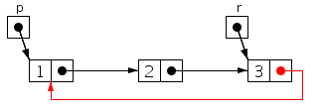

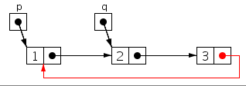
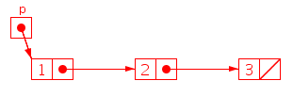
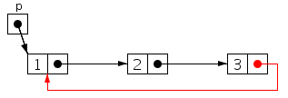
Initial Setup | Exercise | Final Configuration
7 |  | Write a single assignment statement to transform the linked list headed by p into a circular linked list. Your assignment statement must refer to both variables p and r.
8 |  | Redo exercise 7 but, this time, your assignment statement must refer to both variables p and q.
9 |  | Redo exercise 7 but, this time, your assignment statement must refer only to variable p.

Slide 5
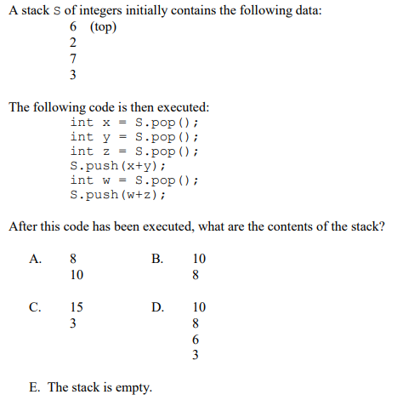

Slide 6
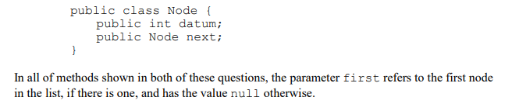
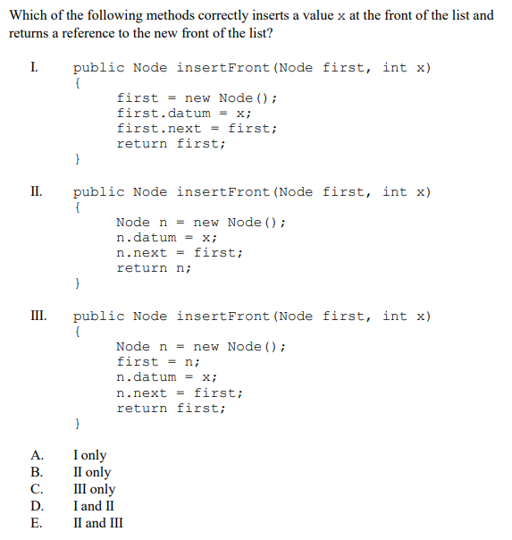
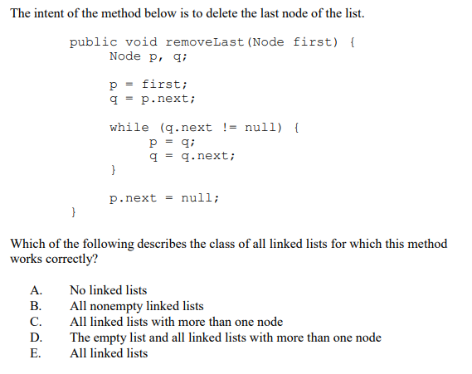

Slide 7
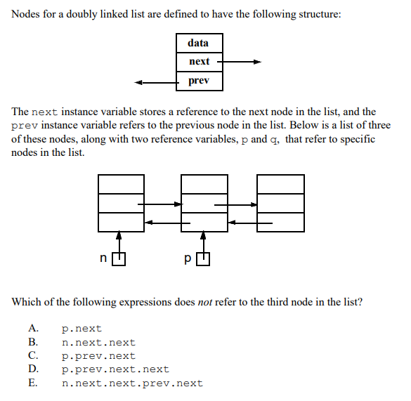

Slide 8
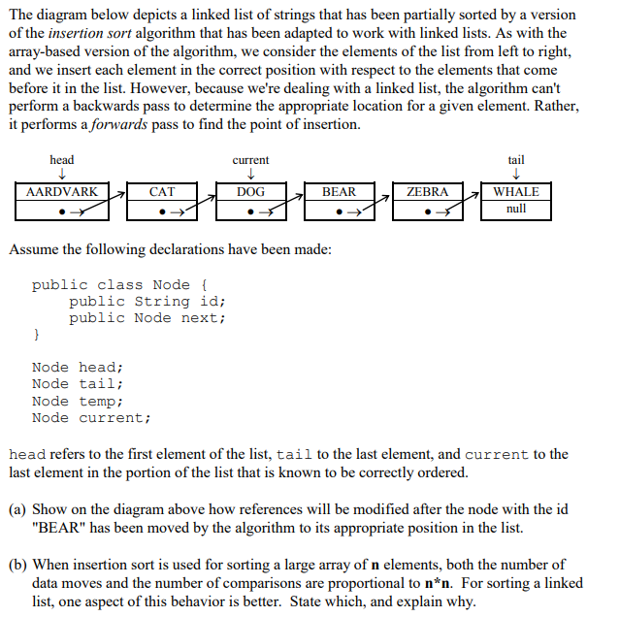
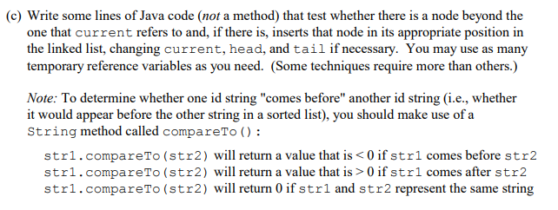
https://sites.fas.harvard.edu/~libs111/files/tests/unit8_practice_test.pdf

Slide 9
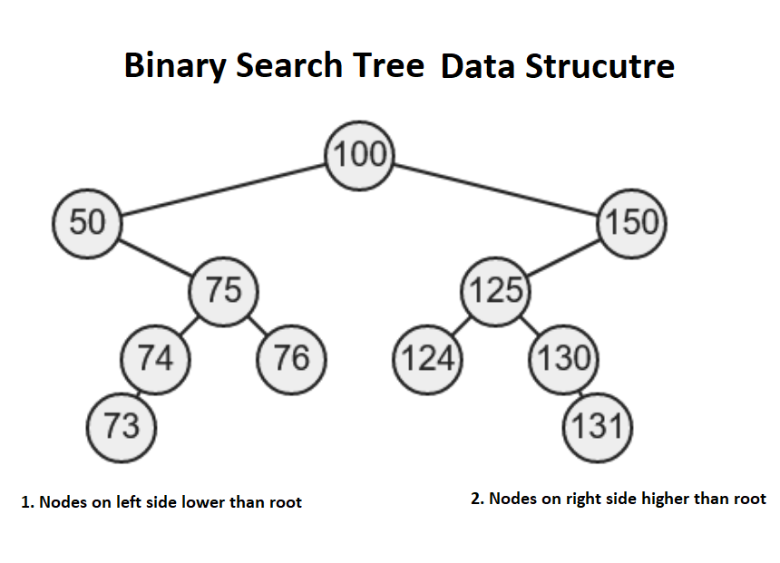
Binary search tree
1. Add a node 2. Delete a node 3. Show min node 5. Show max node 6. Find a node
7.Print all nodes

